Slide 1


Teachable Machine Image Classification System

Slide 2

Team
Ahmed Abo Elyaized El Gohary
Mostafa Mohamed Ahmed
Yassa Adel Thabet
Mohamed Essam Saeed
Omar Ahmed Shwaqy
Eissa Islam Eissa
Supervised by
Eng. Sara Ashraf

Slide 3

Project Overview
Title
Building a Teachable Machine-Like Image Classification System.
Objective
Develop a web application allowing users to upload images Classes, set training parameters, train a classification model, and test it with new images.
Tech Stack
Frontend:
Image Classification.html # UI for uploading images, training, and testing
Image Classification.css # Frontend styles
Image Classification.js # Frontend logic (JS/React/Vue.js)
Backend:
App.py # FlaskI for server-side logic
Model.py # Machine learning model training and testing logic
Deployment: Heroku/AWS/Google Cloud

Slide 4

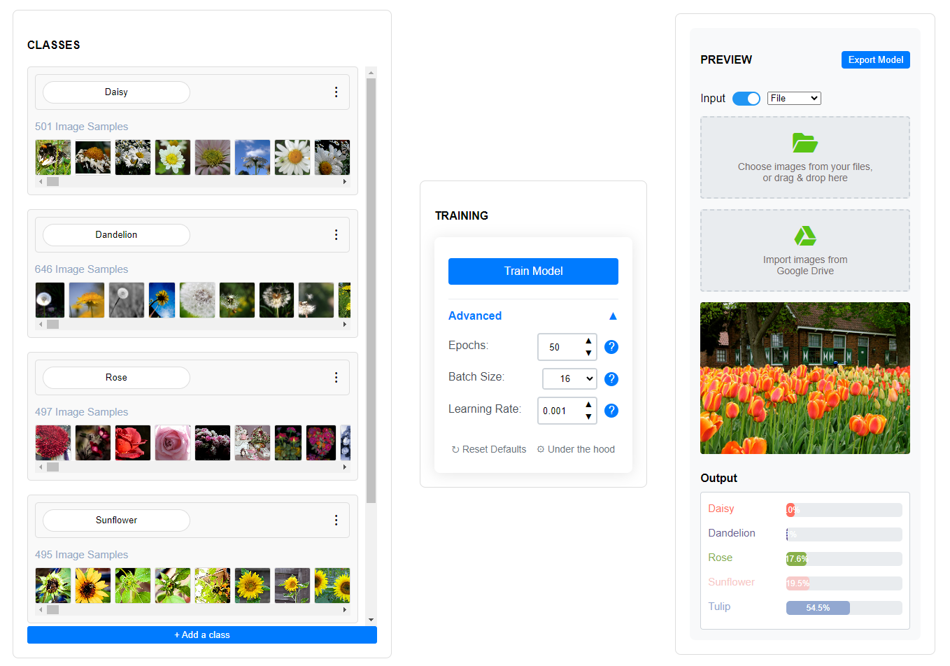
Frontend Setup
UI Components
Class creation & Image Upload:
Add Classes name.
Add Class image samples by upload or Webcam .
Use JavaScript to preview images and track uploads.
Training Parameters:
Include fields for:
Number of epochs (number of training iterations).
Batch size (how many images to process at once).
Learning rate (how quickly the model learns).
Buttons:
Add a “Train Model” button that triggers the backend /train endpoint.
Testing Section:
Add another file upload input to let users upload images for model testing after training.
Apps/Tools:
Visual Studio Code for code editing.

Slide 5


set up APIs to manage the image uploads, model training, and testing.
Endpoints:
/upload: This endpoint should handle file uploads. Store images in a directory or cloud storage (e.g., AWS S3).
/train: This endpoint initiates the training of the CNN model using the uploaded images.
It will take parameters like (epochs, learning rate , batch size.) .
/predict: This endpoint loads the trained model and makes predictions on new images.
Model Training:
Use TensorFlow/Keras to create a CNN model:
Start with Conv2D layers, MaxPooling2D, and Dense layers.
Make the model configurable by user inputs (epochs, learning rate , batch size.).
Implement callbacks like early stopping to prevent overfitting.
Apps/Tools:
Flask (for building APIs)
Postman (to test API endpoints).

Slide 6

Model Training Process
The training logic needs to:
1. Preprocessing: Resize images, normalize data.
2. Model Creation: Build the CNN model architecture using TensorFlow/Keras.
3. Training: Customize training with epochs, batch size, learning rate.
4. Callbacks: Implement early stopping and model checkpoints.
5. Compile the model with a loss function (categorical cross-entropy for classification)
and optimizer (like Adam).
6. Train the model and store it.
Store the trained model in:
HDF5 format for TensorFlow.
Load and save model checkpoints during training.
Apps:
Google Colab for running Python and TensorFlow

Slide 7

Testing and Predictions
Once the model is trained, the /predict endpoint can:
Load the trained model.
Preprocess the test image to match the model input.
Predict on new images uploaded by users using model.predict() .
Display confidence scores and class predictions on the frontend.
User Interaction
Simple drag-and-drop for image uploads.
Real-time display of results on the application interface.

Slide 8

Deployment and Accessibility
After everything is set, package the application for deployment:
Backend:
Set up a Procfile (for Heroku) or an AWS Elastic Beanstalk environment for deployment.
Use Docker for more flexible and consistent deployment environment.
Frontend:
Host frontend on a service like Netlify or include it in the backend deployment (using Flask or FastAPI to serve static files).
Apps/Tools:
Docker (for containerized deployments).
Heroku CLI, AWS CLI, or Google Cloud CLI (for cloud deployment).
Future Enhancements:
Adding more complex models.
Enabling model export for use outside the web app.
Expanding to more types of machine learning tasks.

